Slide 1
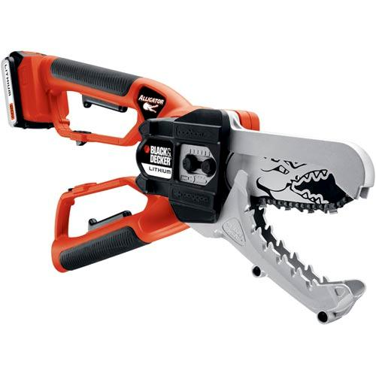
TOOLGATOR
Professional tool hire for tradesmen.

Slide 2
Identification of ToolGator Stakeholders.
ToolGator is a single tool hire warehouse located in Portsmouth.
Direct Stakeholders:
Branch Manager: Nigel Bones.
Staff Members: David Kirk, Fred Scott, John Riker, Bernard Troi.
Benefits from a faster system, easier for employees, fewer errors resulting is profit loss for the manager.
External Stakeholders:
Tradesmen rely on ToolGator for tools for their profession, although a new system will not bring direct benefit, the lower likelihood of errors in an electronic system could potentially mean a better customer experience.

Slide 3
ToolGator’s current system:
ToolGator…
Monitors all tools currently in their inventory – preventing an overflow of orders for an out of stock item.
Keeps track of the return date of each hired tool, its owner, as well as the pending days
Each tool is inspected when returned and its condition recorded, ensuring that each item conforms to any regulations and is safe to use for the next customer.

Slide 4
ToolGator’s current system:
Despite this, the current system is inefficient and prone to errors due to its paper based nature.
Amendments are difficult and increase the chance of damage and errors.
Vulnerable to theft, permanent loss of data.
Illegible handwriting causing problems for other employees.

Slide 5
Goal:
Create a streamlined electronic system for tool hiring with the aim of greater ease of use as well as on the surface simplicity for regular staff members.
Data should be kept centralised so that multiple computers in a network can access the same central file.

Slide 6
Proposed new system for ToolGator :
A modernised, streamlined version of the outdated paper based system that retains all functionality.
Also adds features:
Account logins allowing for multiple security levels (Admin, Staff, Customer Terminal)
Customer details and account logins will be encrypted.
Backup and archiving, utilising Grandfather-father-son.

